Slide 1
Performance Assessment of Hetero-Junction Intrinsic Thin Film (HIT) Photovoltaic Module by Machine Learning Methods
Project guide –
Dr vishwesh vyawahare
Dr Dhiraj Magare
Dr Gajanan birajdar
Project By –
Aditya pandey (18ee1016)
Prasad Kulkarni (18EE1057)
Tushar patil (18EE1162)

Slide 2
Introduction
A Photovoltaic (PV) cell is an electronic component that generates electricity when exposed to photons, or particles of light
It was discovered in 1839 by French physicist Edmond Becquerel
Solar panels, which are made up of PV cell modules, began arriving on rooftops at the end of the 1980s
A photovoltaic cell is comprised of many layers of materials
The most important layer of a photovoltaic cell is the specially treated semiconductor layer
It is comprised of two distinct layers (p-type and n-type)

Slide 3
On either side of the semiconductor is a layer of conducting material which "collects" the electricity produced.
The final layer which is applied only to the illuminated side of the cell is the anti-reflection coating.
The module temperature has a strong impact on the module efficiency, which affects the energy yield.
As the module temperature increases, SC current increases and OC voltage decreases
Wind also influences the temperature of module which affects its performance.
Not only the wind speed but also the wind direction affects the module temperature.

Slide 4
Working of Photovoltaic Cell
A PV cell absorbs the photons emitted by the sun and generates a flow of electrons.
They release the electrons from its atoms, leaving behind a vacant space.
The stray electrons move around randomly looking for another “hole” to fill.
To produce an electric current, the electrons need to flow in the same direction.
This is achieved using two types of silicon:
The silicon layer that is exposed to the sun is doped with atoms of phosphorus.
The other side is doped with atoms of boron.

Slide 5
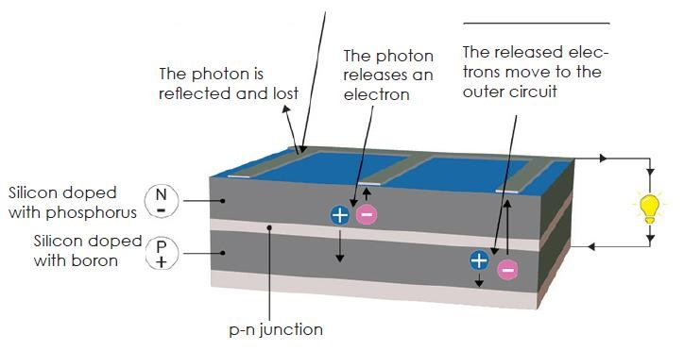
The layer that has surplus electrons becomes the negative terminal (n).
The side that has a deficit of electrons becomes the positive terminal (p).
The excited electrons are swept to the n-side while the holes to the p-side.
The electrons and holes are directed to the electrical contacts applied to both sides.
An anti-reflective coating is added to the top of the cell to minimize photon loss.

Slide 6
Photovoltaic Cell Efficiency
A solar cell absorber should be efficient in absorbing radiation at desired wavelengths.
Efficiency is the ratio of electrical power produced by the cell to the amount of sunlight it receives.
The cells are combined into modules, assembled into arrays and then placed in front of a solar simulator.
The electrical power produced by the system, or peak power, is a percentage of the incoming solar energy.
If a panel measuring 1 m² generates 200 W of electrical power, it has an efficiency of 20%.
The max theoretical efficiency of a PV cell is around 33%. This is the Shockley-Queisser limit.

Slide 7
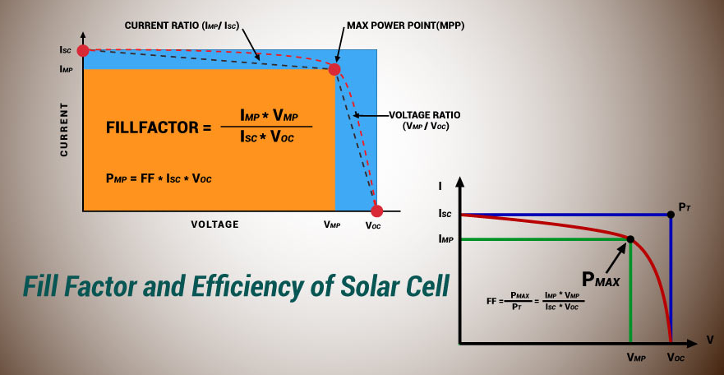
The amount of electricity produced by a cell is based on its efficiency and the average annual sunshine of the surrounding area.
Incident solar radiation varies significantly, for example, measuring 1 MWh/m²/y in the Paris area

Slide 8
Structure and Fabrication of HIT
HIT is the abbreviation of Heterojunction with Intrinsic Thin-layer.
Since HIT has been applied for a registered trademark by Sanyo Corporation, it is also called HJT or SHJ.
Heterojunction solar panels are composed of three layers of photovoltaic material.
HJT cells combine two different technologies:
Amorphous “thin-film” silicon - It catches sunlight as well as the light that reflects off the below layers.
Monocrystalline silicon - It is responsible for turning most of the sunlight into electricity.
Behind the crystalline silicon is another amorphous thin-film silicon layer.
This final layer captures the remaining photons that surpass the first two layers

Slide 9
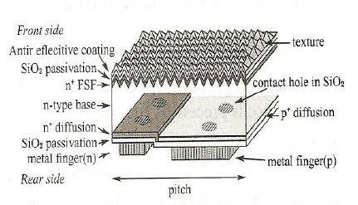
The basic structure of a HIT solar cell, which is characterized by:
A pi-type a-Si film (film thickness 5-10 nm) on the light irradiation side.
An n-type a-Si film (film thickness 5- l0nm) sandwiching a crystalline silicon wafer.
This forms electrodes and collectors on the top layers on both sides to form a HIT solar cell.

Slide 10
Fabrication of hit
Typically, good quality, CZ/FZ grown c-Si wafers are used as the absorber layer.
Using alkaline etchants, such as NaOH is textured to form the pyramids of 5-10μm height.
Next, the wafer is cleaned using peroxide. This is followed by deposition of the intrinsic a-Si passivation layer.
The silane (SiH₄) gas diluted with H₂ is used as a precursor.
The deposition temperature and pressure are maintained at 200º C and 0.1 Torr.

Slide 11
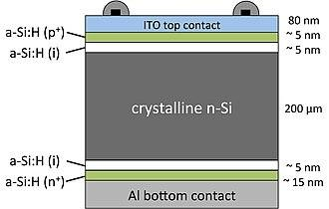
Diborane or Trimethyl boron gas mixed with SiH₄ is used to deposit a p-type a-Si layer.
Phosphine gas mixed with SiH₄ is used to deposit an n-type a-Si layer.
Sputtered ITO is commonly used as a TCO layer on top of the front and back a-Si layer
The silver/aluminum grid of 50-100μm thick is deposited for the front contact and back contact.

Slide 12
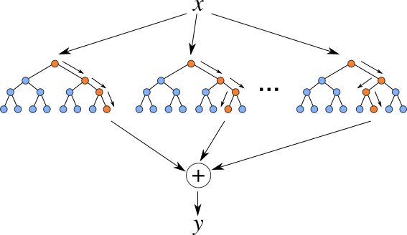
Random forest Regression Method
It is a supervised learning algorithm that uses ensemble learning method for regression.
This combines predictions from multiple algorithms to make a more accurate prediction.
The trees run in parallel with no interaction amongst them.
It uses several decision trees during training time and outputting the mean of the classes as the prediction.
It usually performs great on many problems, including features with non-linear relationships.

Slide 13
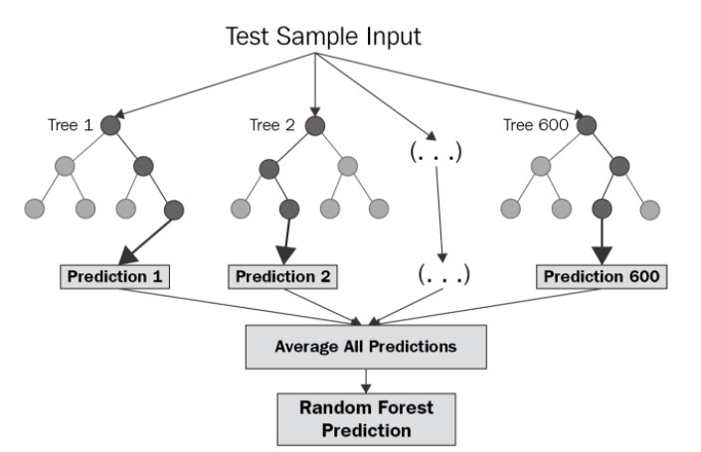
Disadvantages:
No interpretability
we must choose the number of trees to include in the model.
Unable to discover trends that would enable it in extrapolating values that fall outside the training set.
The ensemble of decision trees has high accuracy because it uses randomness on two levels:
The algorithm randomly selects a subset of features.
Each tree draws a random sample of data from the training dataset when generating its splits.

Slide 14
PROGRESS
Predicted the module temperature and maximum power output successfully by training the model using one year's data
Identified the type of relation between the independent and dependent parameters
Improved the accuracy by 4%
Calculated the RMSE value and the error in prediction

Slide 15
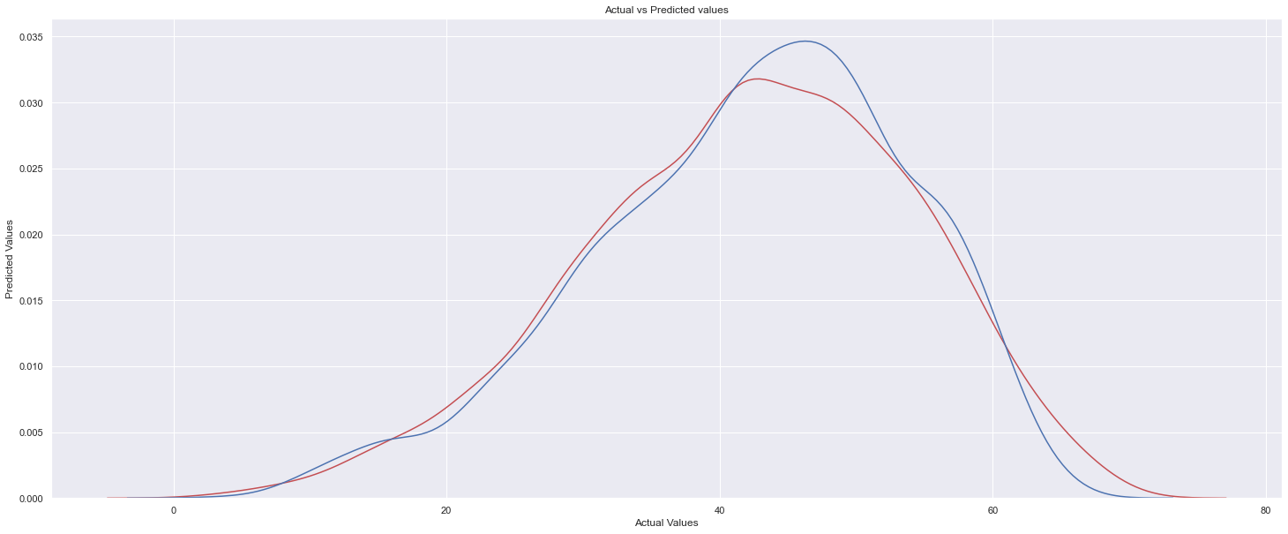
RESULTS AND OBSERVATIONS
Module Temperature

Slide 16
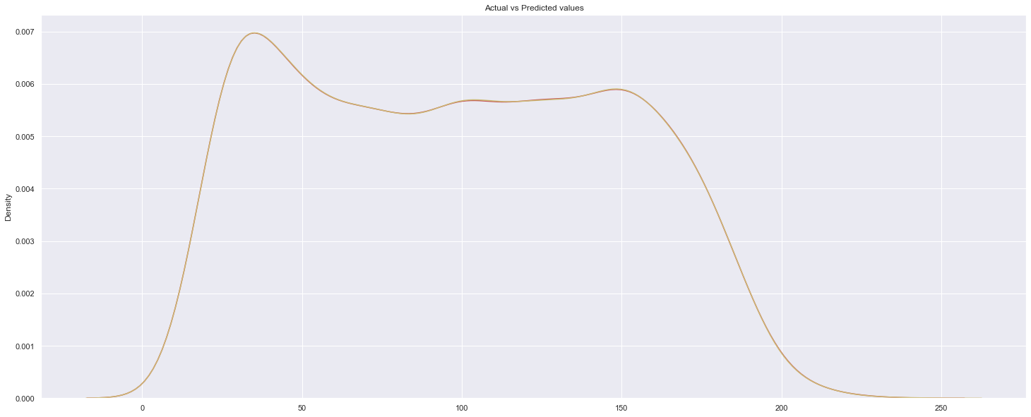
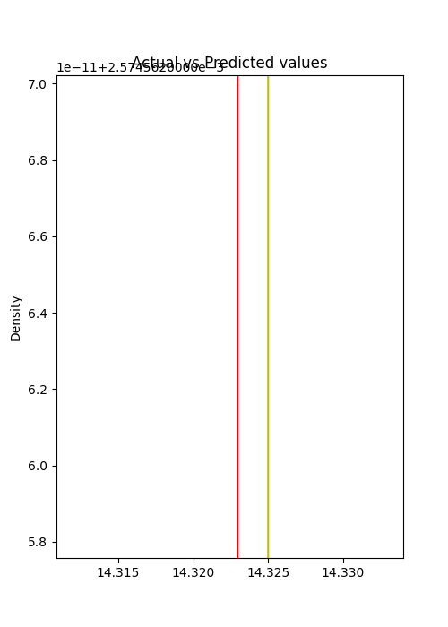
Maximum Power

Slide 17
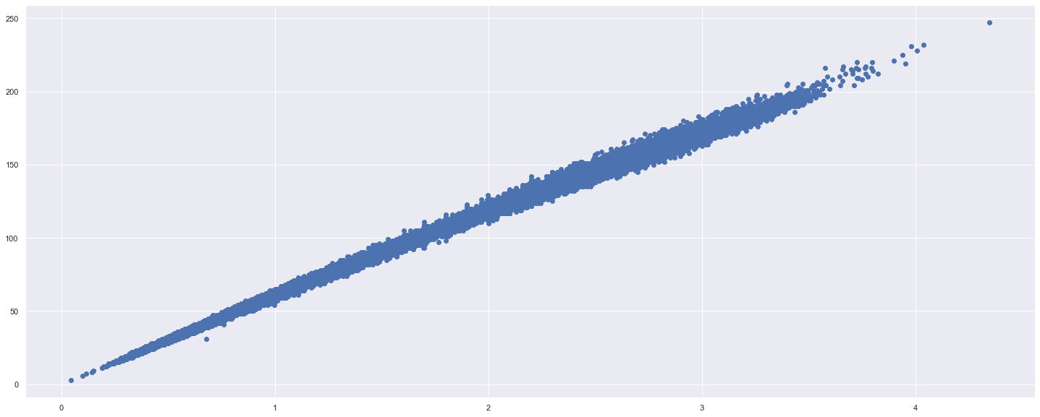
Ipmax vs Pmax

Slide 18
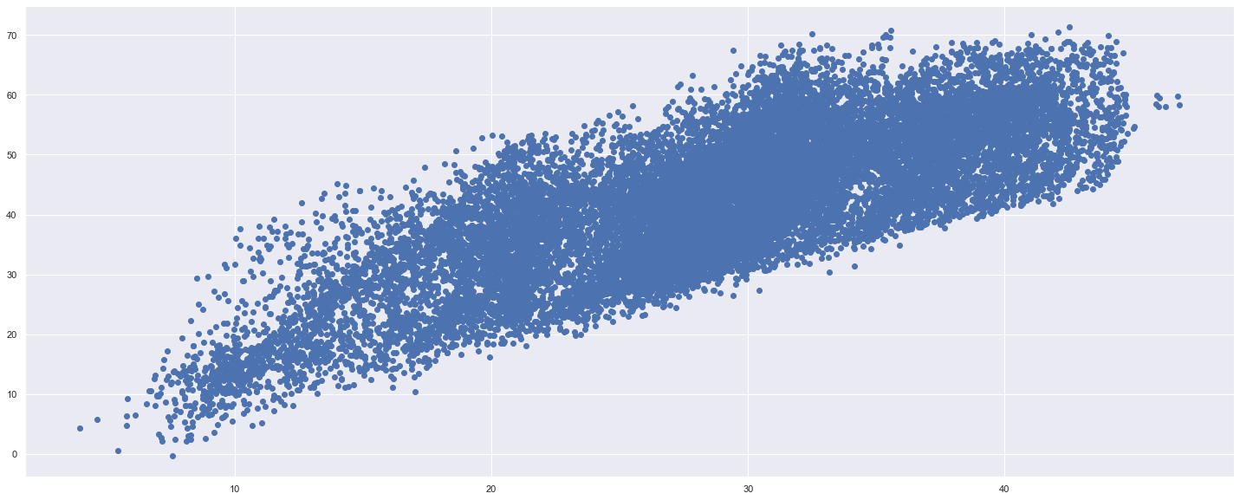
Tamb vs Temp_mid_avg

Slide 19
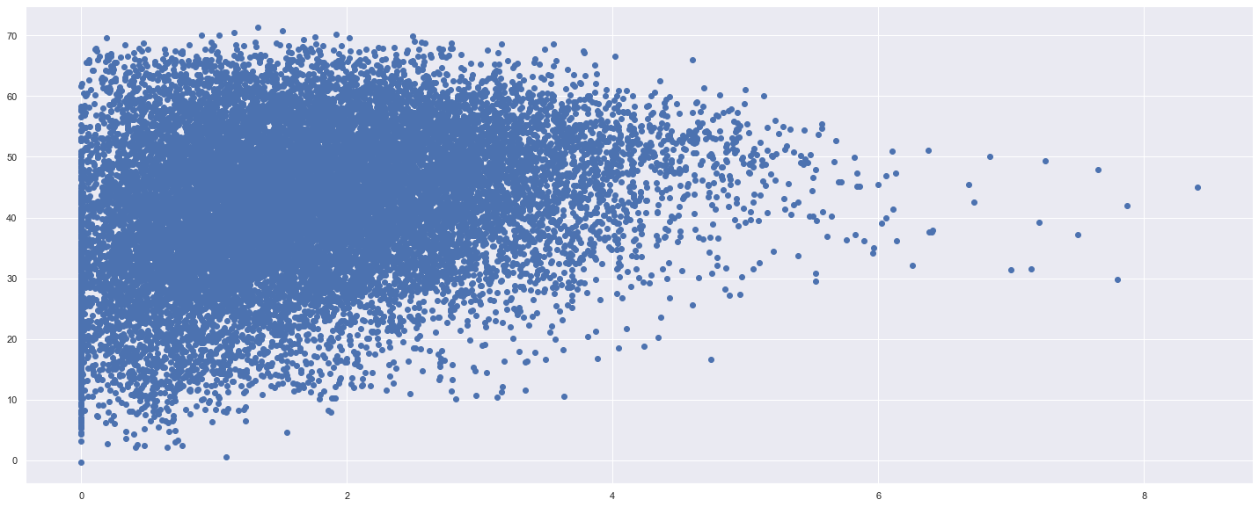
Ws vs Temp_mid_avg

Slide 20

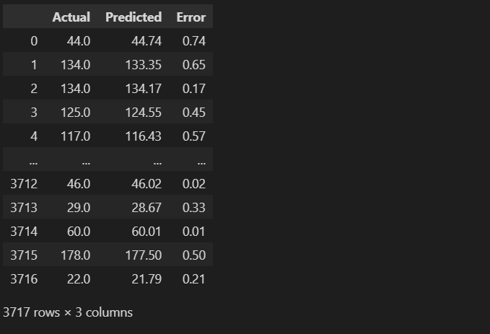


Module Temperature
Maximum Power

Slide 21
FUTURE WORK
Train the model using the data of a year and predict another year’s data then compare the results.
Since a season affects a photovoltaic module performance, we will also train the model to predict season-wise performance.
Improve the accuracy by using tuning classifiers.

Slide 22
Conclusion
In Conclusion, we are using the Random Forest Regression method of machine learning to predict the maximum output power and the module temperature under the parameters by which the predictions can vary.

Slide 23
THANK YOU

